Slide 1



Naartjie
Seamlessly splitting payments
UCT and Interledger hackathon
June 2024

Slide 2
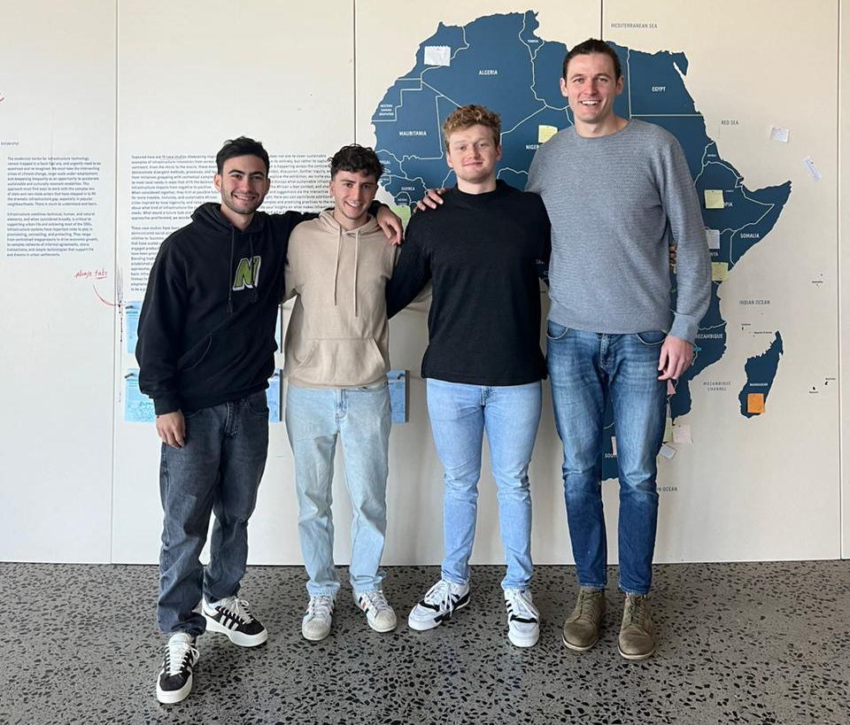
Meet the team
Team Naartjie
Don Rom – “Dan the man”
Dylan Trowsdale – “Dynamite Dyl”
Shaun Brick – “Birthday boy”
Johan Brits – “I did ActSci”

Slide 3
Problem statement
The OpenPayments protocol only enables payments on a one-to-one basis: one payer, one recipient
Naartjie extends the Interledger capability to enable many-to-many payments:
Many payers, many recipients, one transaction
Naartjie is set up as a SaaS application which can integrate into mutiple platforms that is unique to the Interledger Protocol (ILP) – the ILP uniquely positioned to solve this problem
Why this is a problem worth solving
Reduce friction in system
Create trustless ecosystem to enable payments
Reduce credit and liquidity risk
Unlock funding opportunity for merchants, content creator

Slide 4





Splitting an outgoing payment
Current solution
All parties pay a single party to execute a single transaction on their behalf
Sarah
Alice
Marketplace
Speedy Fridges
Alice and Sarah buy a fridge together.
Alice pays for the fridge on Takealot
Alice loads the purchase amount on Splitwise
Sarah repays Alice the Splitwise amount

Slide 5
Splitting an outgoing payment
Alice
Current solution
All parties pay a single party to execute a single transaction on their behalf
Marketplace
Speedy Fridges
Sarah
Naartjie’s solution
Enable all parties to seamlessly participate in a single transaction simultaneously
Alice and Sarah buy a fridge together.
Alice and Sarah each make a payment for the fridge
Done

Slide 6

Splitting an incoming payment
Alice
Current solution
One party receives a payment
Secondary payment(s) to other recipient(s)
Marketplace
Speedy Fridges
Funder/
Supplier
Sarah
Speedy Fridges receives a payment for a fridge
At month-end, Speedy Fridges pay their Supplier/Funder
The Funder/Supplier charges 8% interest

Slide 7
Splitting an incoming payment
Alice
Speedy Fridges
Current solution
One party receives a payment
Secondary payment(s) to other recipient(s)
Marketplace
Funder/
Supplier
Sarah
Naartjie’s solution
Split incoming payment seamlessly among recipients on agreed upon terms
Speedy Fridges receives a payment for a fridge
The payment is split between Speedy Fridges and its Funder/Supplier on an agreed upon terms
The Funder/Supplier charges 5% interest

Slide 8
Technical components
Initialize four incoming payments and store details on client server
Generate four quotes – two incoming and two outgoing payment grants
Request authorization from each user – authorization key generated
Perform key rotation to ensure a single authorization key can be used to authorize multiple payments within the same transaction
Four payments processed:
2 outgoing payments from each user (client 1 and client 2)
2 incoming payments for each recipient (merchant and funder)

Slide 9
Additional applications of the solution
Asset Tokenization
Multiple investors to purchase a fraction of a single asset simultaneously
Single asset’s return paid to multiple owners of the asset
Insurance and Stokvels
Multiple policyholders contribute to single insurance pool
Single insurance pool pays to multiple claimants
Stokvel application to savings instead of insurance

